Slide 1

THIS RIDE IS ON US
Sam Nieland
Aparna Reddy
Linnea Whitney
Mike Montalbano
Robert Dearwester
Notes:
Sam to start then have everyone introduce themselves

Slide 2

Overview and Goals
North Tahoe/Truckee Tipsy Taxi is a donation-based door to door transportation service provided to North Tahoe/Truckee residents every Thursday, Friday and Saturday night.
The goal of North Tahoe/Truckee Tipsy Taxi is to change the culture in regards to driving under the influence, to keep intoxicated drivers off of the road, and provide an alternate source of transportation.
Notes:
AR
In order to establish our goals we have 6 objectives which Linnea will take us through.

Slide 3
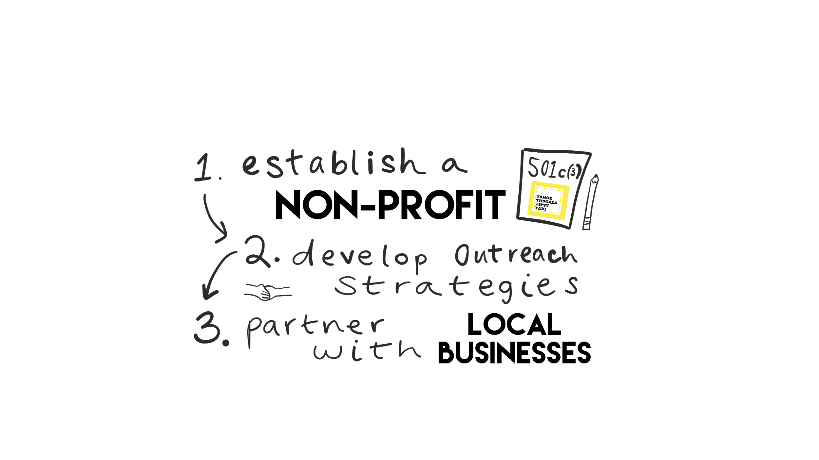
Timeline
Notes:
Linnea - - Timeline graphic and discuss the objectives
1. Establish non-profit organization
2. Develop outreach strategies, i.e. posters, flyers, stickers and logos.
3. Partner with local businesses to secure funding for the program.
4. Purchase 1-2 vans which will determine areas of service.
5. Secure a list of local volunteer drivers.
6. Establish a schedule of drivers and driving times.

Slide 4
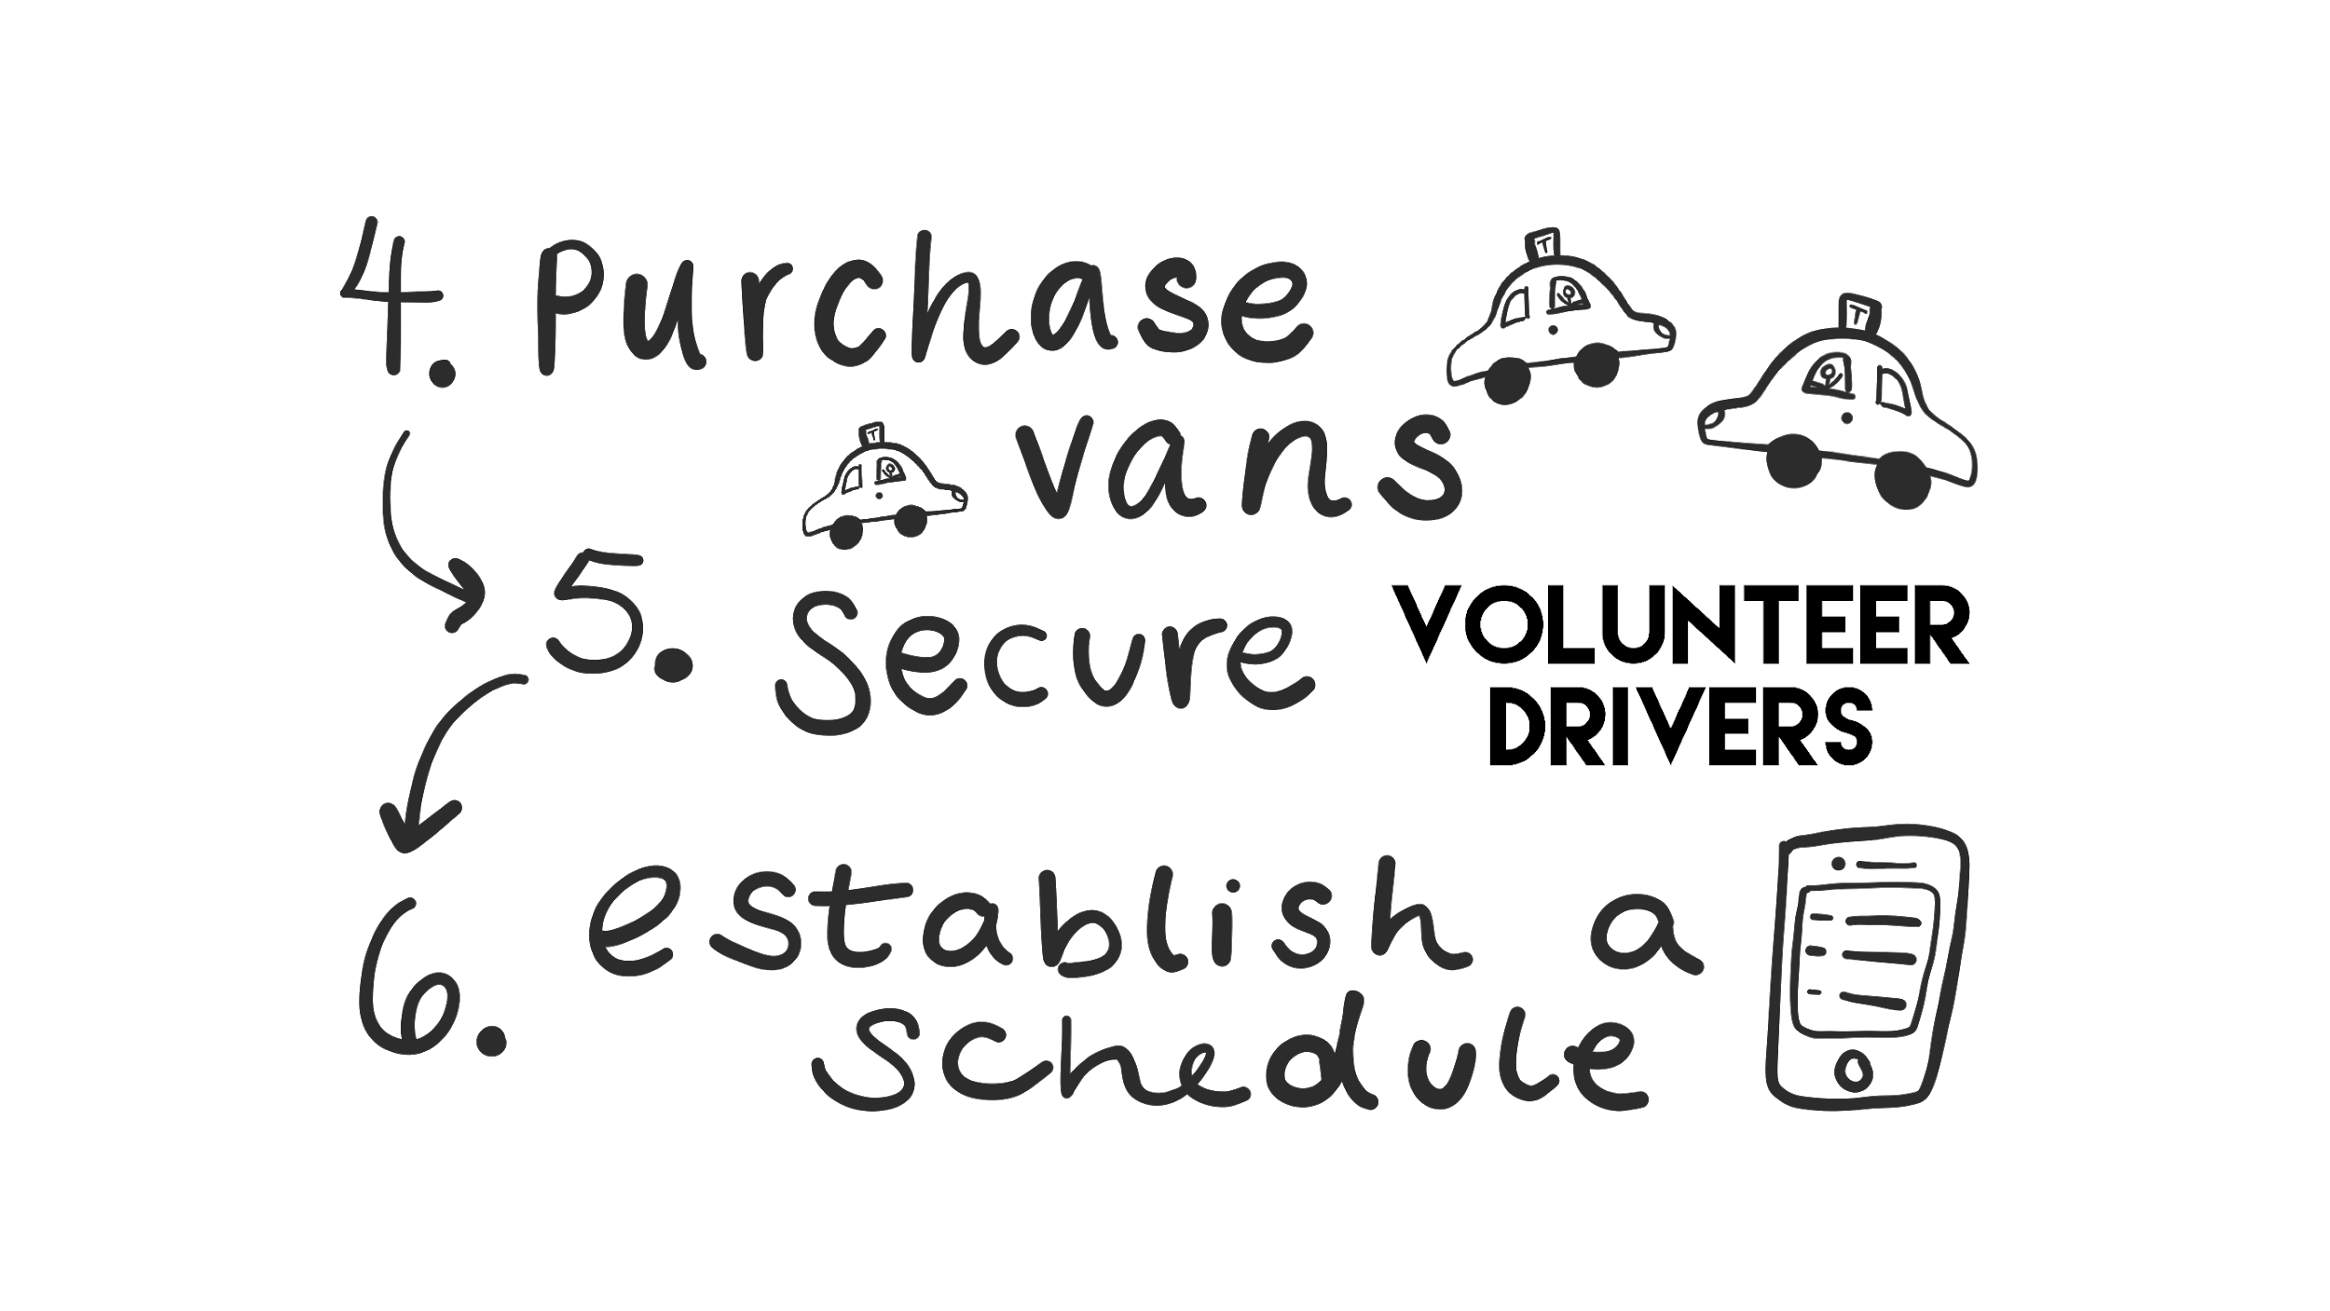

Slide 5
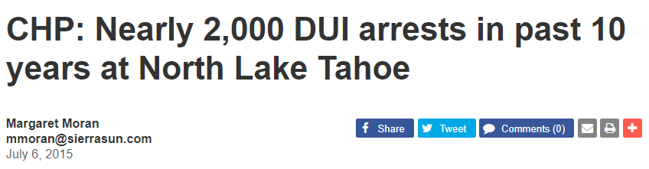
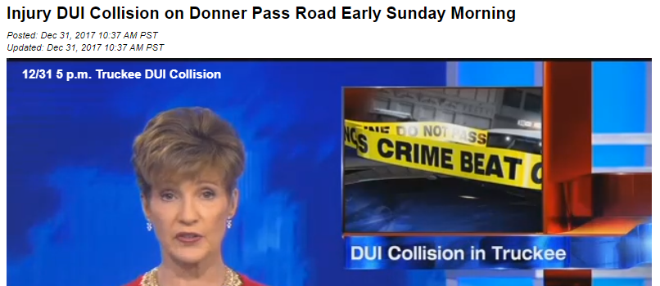
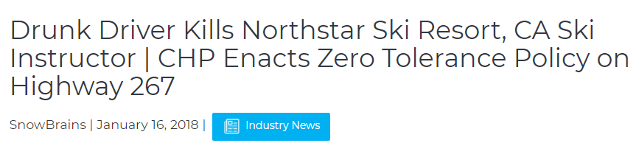
Needs Assessment Impacts
Notes:
Bob
On Saturday January 13, 2018 our community, a family, countless friends and hundreds of coworkers suffered yet another senseless loss. A head on crash on California State Route 267 claimed the life of a local resident. This incident like so many others could have been prevented.

Slide 6

Stats

Slide 7

Adults drink too much and drive about 121 million times per year - or more than 300,000 incidents of drinking and driving a day.
Notes:
BOB-To put this in perspective this number represents 18x the year round population of Truckee drinking and driving in one single day.
Mike - Truckee has a year round population of approximately 16,000 people. Again, the number of daily incidents is 18x the population.

Slide 8

That’s 29 deaths every day and one death every 50 minutes.
Notes:
Bob
-This is like ⅔ of the Town of Truckee dying in one year.

Slide 9

That’s almost three deaths every day and one death every eight and a half hours.
Notes:
Bob
-This is like a lottery. If you drive or ride in a car, you have entered into the daily lottery where 3 people will never come back.
-Each and every one of the deaths in the above stats are preventable.

Slide 10
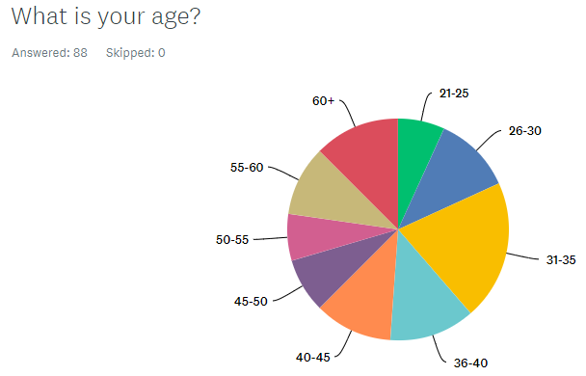
Target Groups
Consumers, 21-44 years old
Volunteer Drivers
Strategic Partnerships with local sponsors
Working in conjunction with bars & establishments for referrals
Notes:
Mike
Businesses to sponsor
Consumers
-income levels to show free/donation based needed
-More than half of all road traffic deaths occur among young adults ages 21-44.
Community drivers & dispatch
-small town, community activism/involvement
Bars to spread the word / refer
AR: Mike did a great job of outlining the target groups for this project, our next slide discusses how we foucs in on these targets

Slide 11
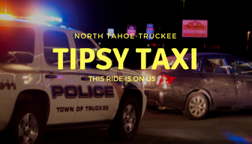
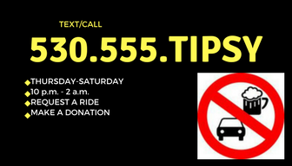
Marketing Plan
Grass Roots Marketing Campaign aimed at positively
impacting individuals, community, and society.
-Consumers/Patrons
-Drivers/Volunteers
-Bars & Establishments
Notes:
Aparna Intro
Mike:
-Include photo from front page
-business cards to hand out - strategy around passing them out (need 10-20) pieces
-synergy with local bars
-”This Ride Is On Us!”
-Flyers posting around town - bars, coffee shops, highly visible central areas
-Marketing to all levels
-Individual - appeals directly to the target consumer
-Community - make the community safer by reducing the number of drunk drivers
-Society - those that utilize and those that volunteer will provide a broad impact
Social Media

Slide 12
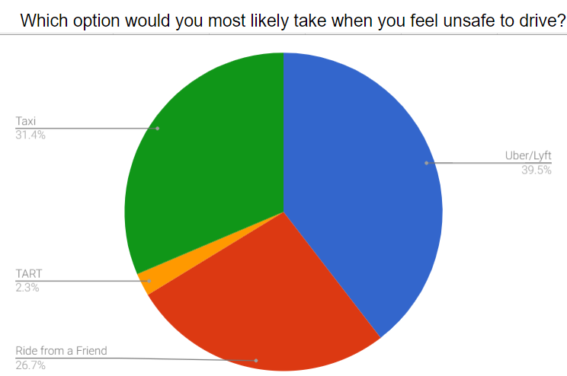
Surveys
Notes:
SAM’S SLIDE
-Availability of these options
-Affordability of these options

Slide 13
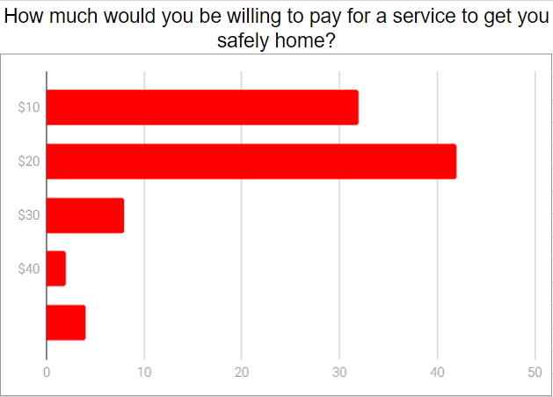
Notes:
Talk to: Taxi’s costing more than $20/$10
We were surprised and encouraged by this result

Slide 14
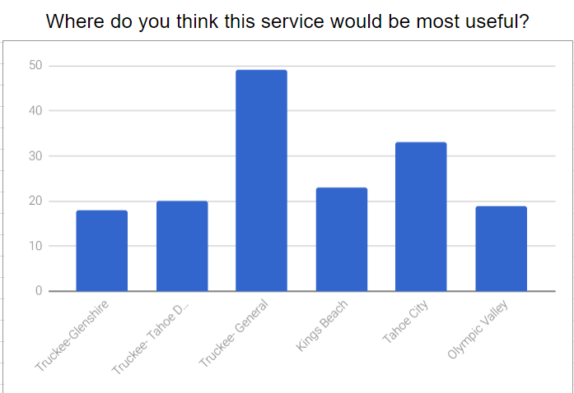

Slide 15
Initial Budget
Van $2,300
Insurance $1,800
Gas $300
Phones / Phone Number $200
Flyers / Posters / Stickers $400
=$5,000
Notes:
AR
-Blanket insurance to cover multiple drivers
-Phones: 2 phones to have one with dispatch and one with the van
-Flyers/ posters/stickers to get the word out so we can get community buy-in

Slide 16
Additional Budget Considerations
Sponsors
Donors
Business Advertising
Start in Truckee, expand to North Tahoe
Notes:
AR
Sponsors
Companies
Organizations
Donors
-Time
-Money
Business Advertising
-Wrap Vans
-Flyers
Start in Truckee, expand to North Tahoe

Slide 17
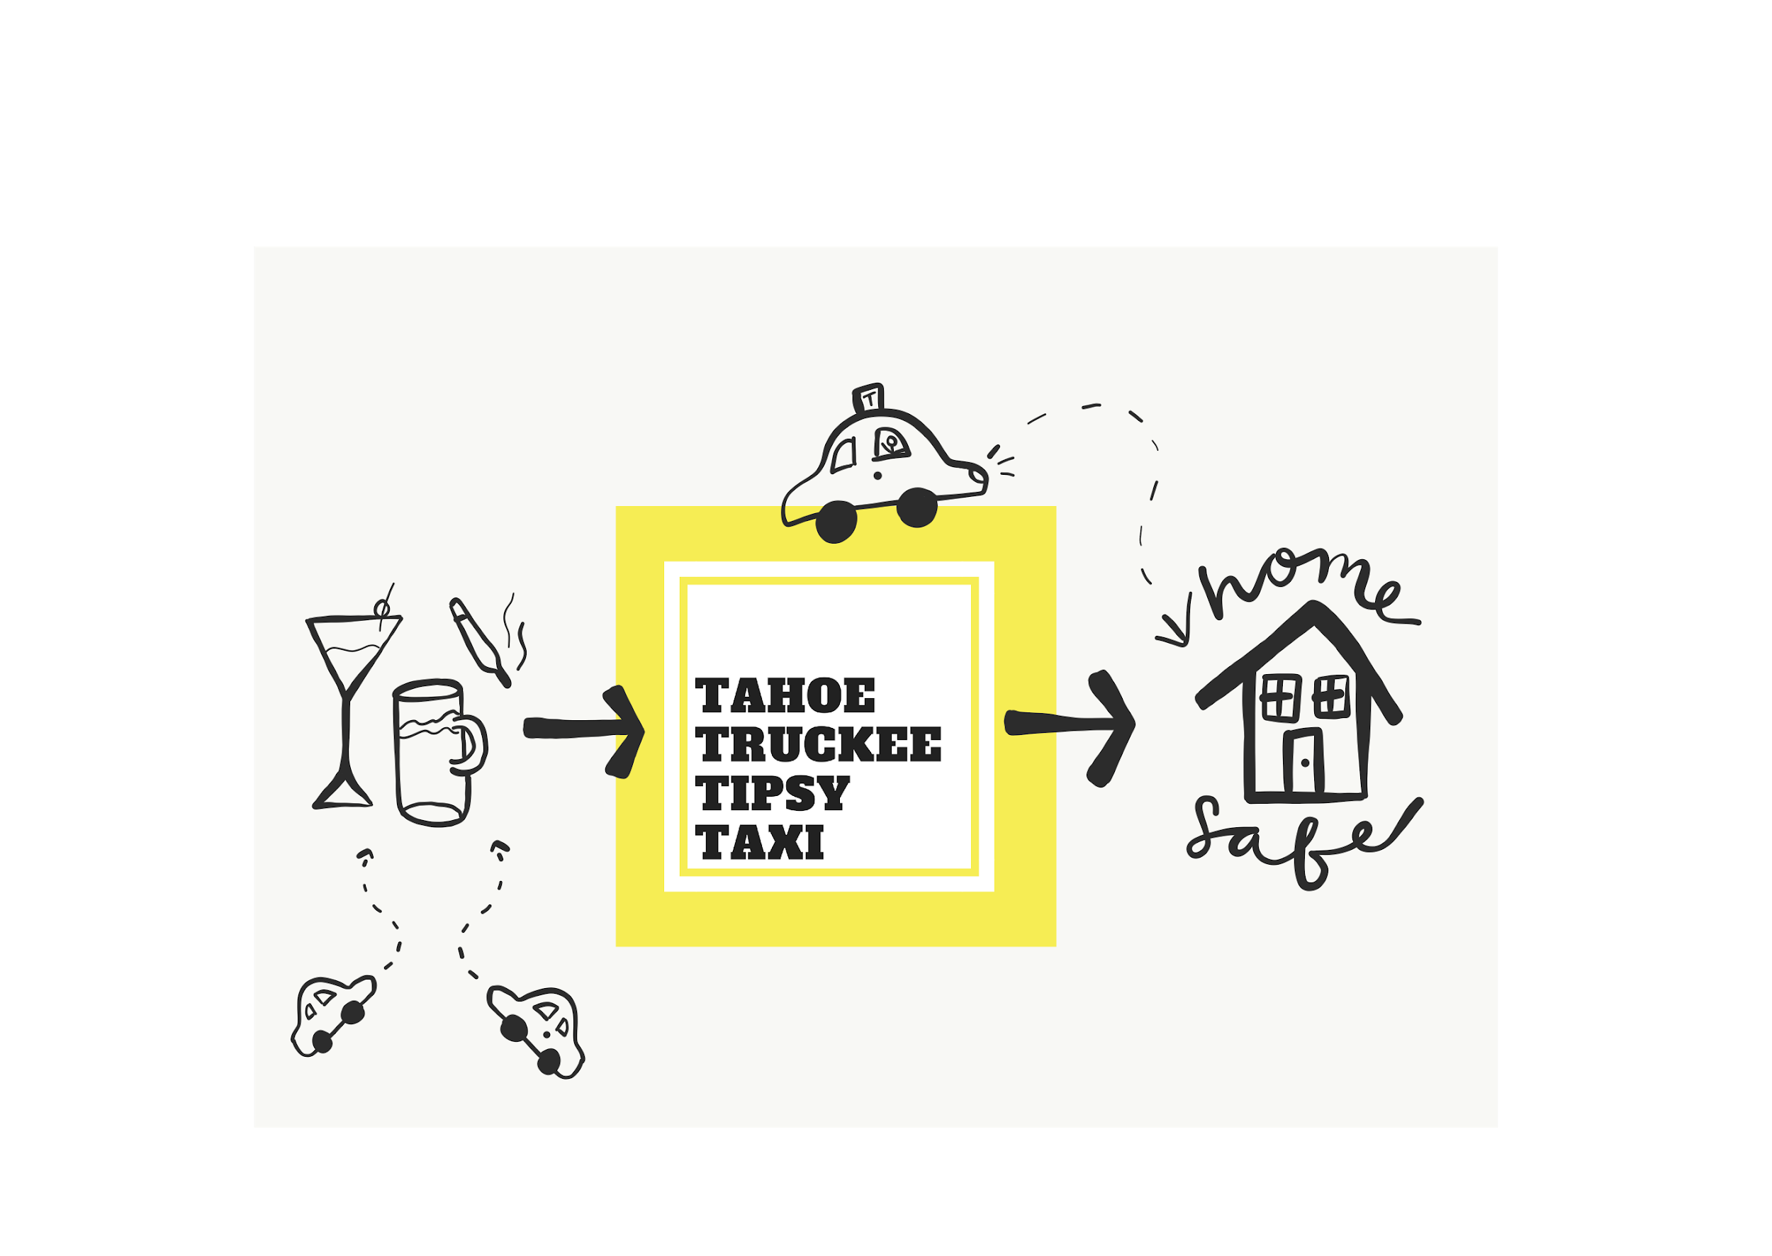

Slide 18

North Tahoe-Truckee Tipsy Taxi...
Notes:
This Ride is on us! So get out there and have fun.

