Slide 1

Tahoe Career Compass
Never Stop Excelling
Presented by: Cristina Munoz, Courtney Platt, and Heiko Mueller

Slide 2
Our Vision
Tahoe Career Compass is a mentorship program for young professionals and students in the Tahoe-Truckee region. Our purpose is to provide mentees the general and specific resources to build their careers. We want to prepare and retain our current and future generation of workers.
Notes:
Cristina

Slide 3
Our Impact: Etiquette, leadership, and career preparation for local mentees
Interviewing, resumes, cover letters, interpersonal skills, and professional communication
Gain mentors and contacts for networking
Leadership capabilities and personality types
Notes:
Cristina

Slide 4
Young Workers
COVID affected the labor market, education, and training opportunities
Post-COVID – Only 45% of California’s young people aged 16-24 are working
Notes:
https://www.labor.ucla.edu/wp-content/uploads/2023/11/DownloadedNov7_Young-Workers-in-California.pd
Cristina

Slide 5

What does the Tahoe-Truckee Region need?
Two surveys needed to assess the needs of mentors and mentees
Variety of businesses responded including:
  Agriculture, forestry, fishing, mining, manufacturing, construction, transportation, public utilities, wholesale trade, finance, insurance and real estate
8-10 hours per week to commit to a mentee with a 6-8 week program length
Majority of businesses needed onboarding assistance
Survey Assessment-Mentors
Notes:
Courtney
We decided we would need two surveys to find out the needs of our community; for mentors and one for mentees.
We had a wide variety of businesses respond to our mentor surveys including:
Agriculture, forestry, fishing, mining, manufacturing, construction, transportation, public utilities, wholesale trade, finance, insurance and real estate
The majority of our responders could put in 8-10 hours per week to commit to a mentee with a 6-8 week program length.
We also asked how much outside help would be needed within a company and the majority of responses would like more help with their onboarding process
Overall, we gained some good insight as how to structure our mentorship program and some needs throughout the community

Slide 6

What does the Tahoe-Truckee Region need?
Less responses for mentee survey
Interests included:
  Agriculture, forestry, fishing, mining, construction, manufacturing, public utilities and transportation, wholesale trade, retail trade, finance, real estate and insurance
The main age demographic that responded was 26 years and older
8-10 hours a week for 6-week program
Survey Assessment-Mentees
Notes:
Courtney
Initially, we had a hard time getting responses from our younger generation. As the weeks went on, we were able to do more specific outreach for the youth and this allowed for more feedback.
We also had a wide variety of interests in different programs including:
Agriculture, forestry, fishing, mining, construction, manufacturing, public utilities and transportation, wholesale trade, retail trade, finance, real estate and insurance
The main age demographic interested in our program were 26 years and older.
8-10 hours a week for 6 weeks were what most said they would be able to dedicate to a program like this which matches with our mentor survey

Slide 7
Aligning Mentor and Mentee Interests
Notes:
Courtney
-We had 6 main businesses types that responded to our mentor survey. The biggest being Public Administration, second we had transportation and public utilities, then healthcare, engineering and public service.
-On our mentee side, the main interest was the group of finance, insurance and real estate. Next we had a tie between all the other areas that included agriculture, forest and fishing, then community development, retail trade, engineering and public service.

Slide 8
Survey Conclusions
Aligned expectations between mentors and mentees
Gave us the general ideas of what each group could commit to
More marketing in 18 and underage range; need to address target specific marketing for that age group
Variety of businesses responded giving us a large pool to choose from
What we learned and where we can improve
Notes:
Courtney
It was great to see that a lot of our survey results between mentors and mentees aligned for expectations.
Having a general idea of what both parties could commit to between program length, program specialties and areas that we could look into to recruiting for possible needs of mentors was very helpful with the responses.
We did not have any feedback of ages 18 and younger so focusing on more marketing in areas like the high school, job fairs or businesses employing teens might be helpful. We hoped that this would be our main age group that the program could benefit so looking more into how we could spread info should be explored.
Knowing the variety of businesses available and willing to be a part of the program was also great as a resource moving forward as we could help promote our vision and use that as a marketing tool.

Slide 9

Notes:
Heiko
LinkedIn

Slide 10
Marketing Strategies
Implement personalized engagement strategies with targeted Posters and a Video
Tailor campaigns like Facebook ads., QR-codes, LinkedIn Video Add to resonate with specific demographics and fostering a sense of relevance and connection with a Graduation sticker
Collaborate with influencers and thought leaders to amplify our brand message
Notes:
Heiko
Let's dive into our Marketing Strategie.
You just saw our LinkedIn add. There we can reach Mentors and Mentees
[KLICK] Our team is actively engaged in personal outreach, connecting with potential mentees and mentors directly.
We're utilizing targeted (region, day time, demographic requirements etc.) Facebook advertisements to reach our ideal audience. You also saw our LinkedIn Campaign.
[KLICK] Posters targeting both students and mentors have been created and strategically placed around the Tahoe-Truckee region.
We've developed a compelling video that showcases the program's benefits.
[KLICK]Finally, a Mentee will receive a cool sticker for participating in the program, which follows our marketing color pattern and presents our logo that you saw on all our marketing material.

Slide 11

Notes:
Heiko
For Facebook and email blasts

Slide 12
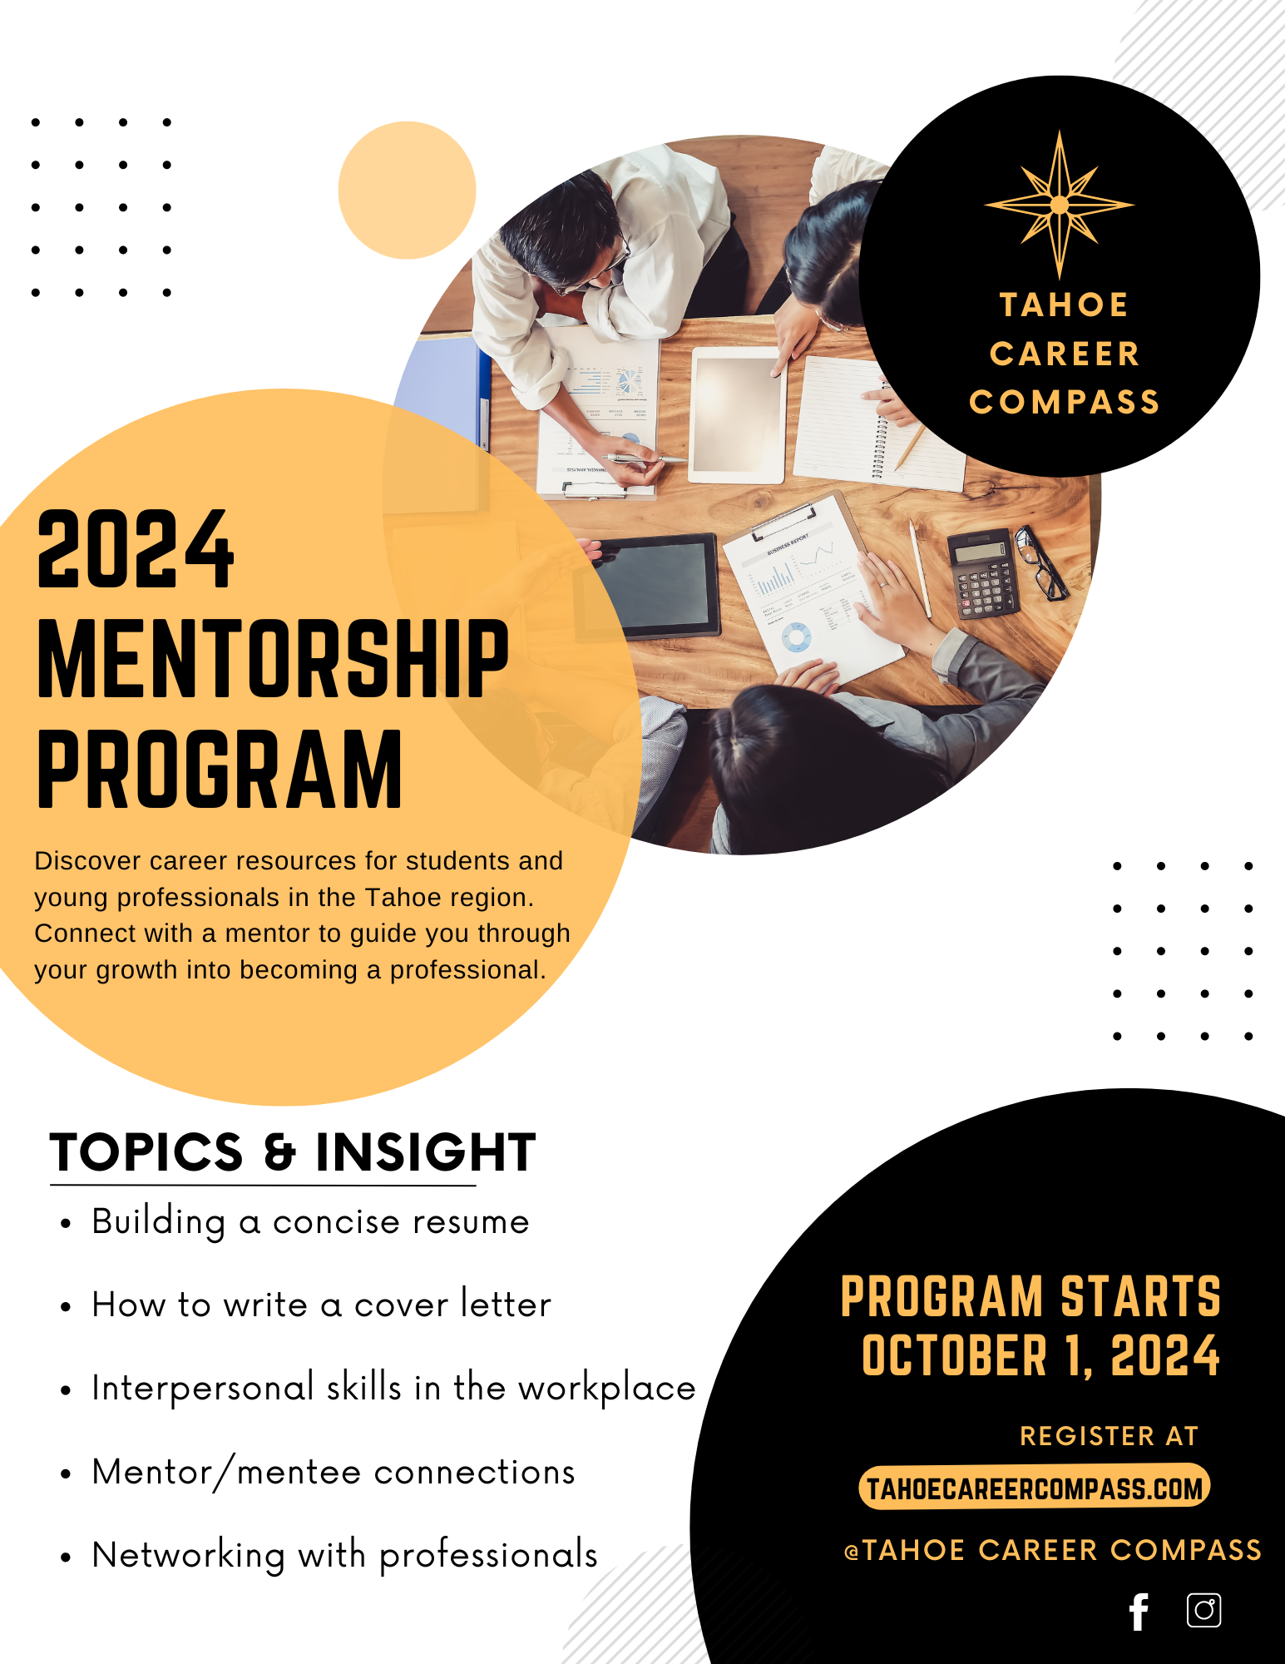
Notes:
Heiko
For college

Slide 13
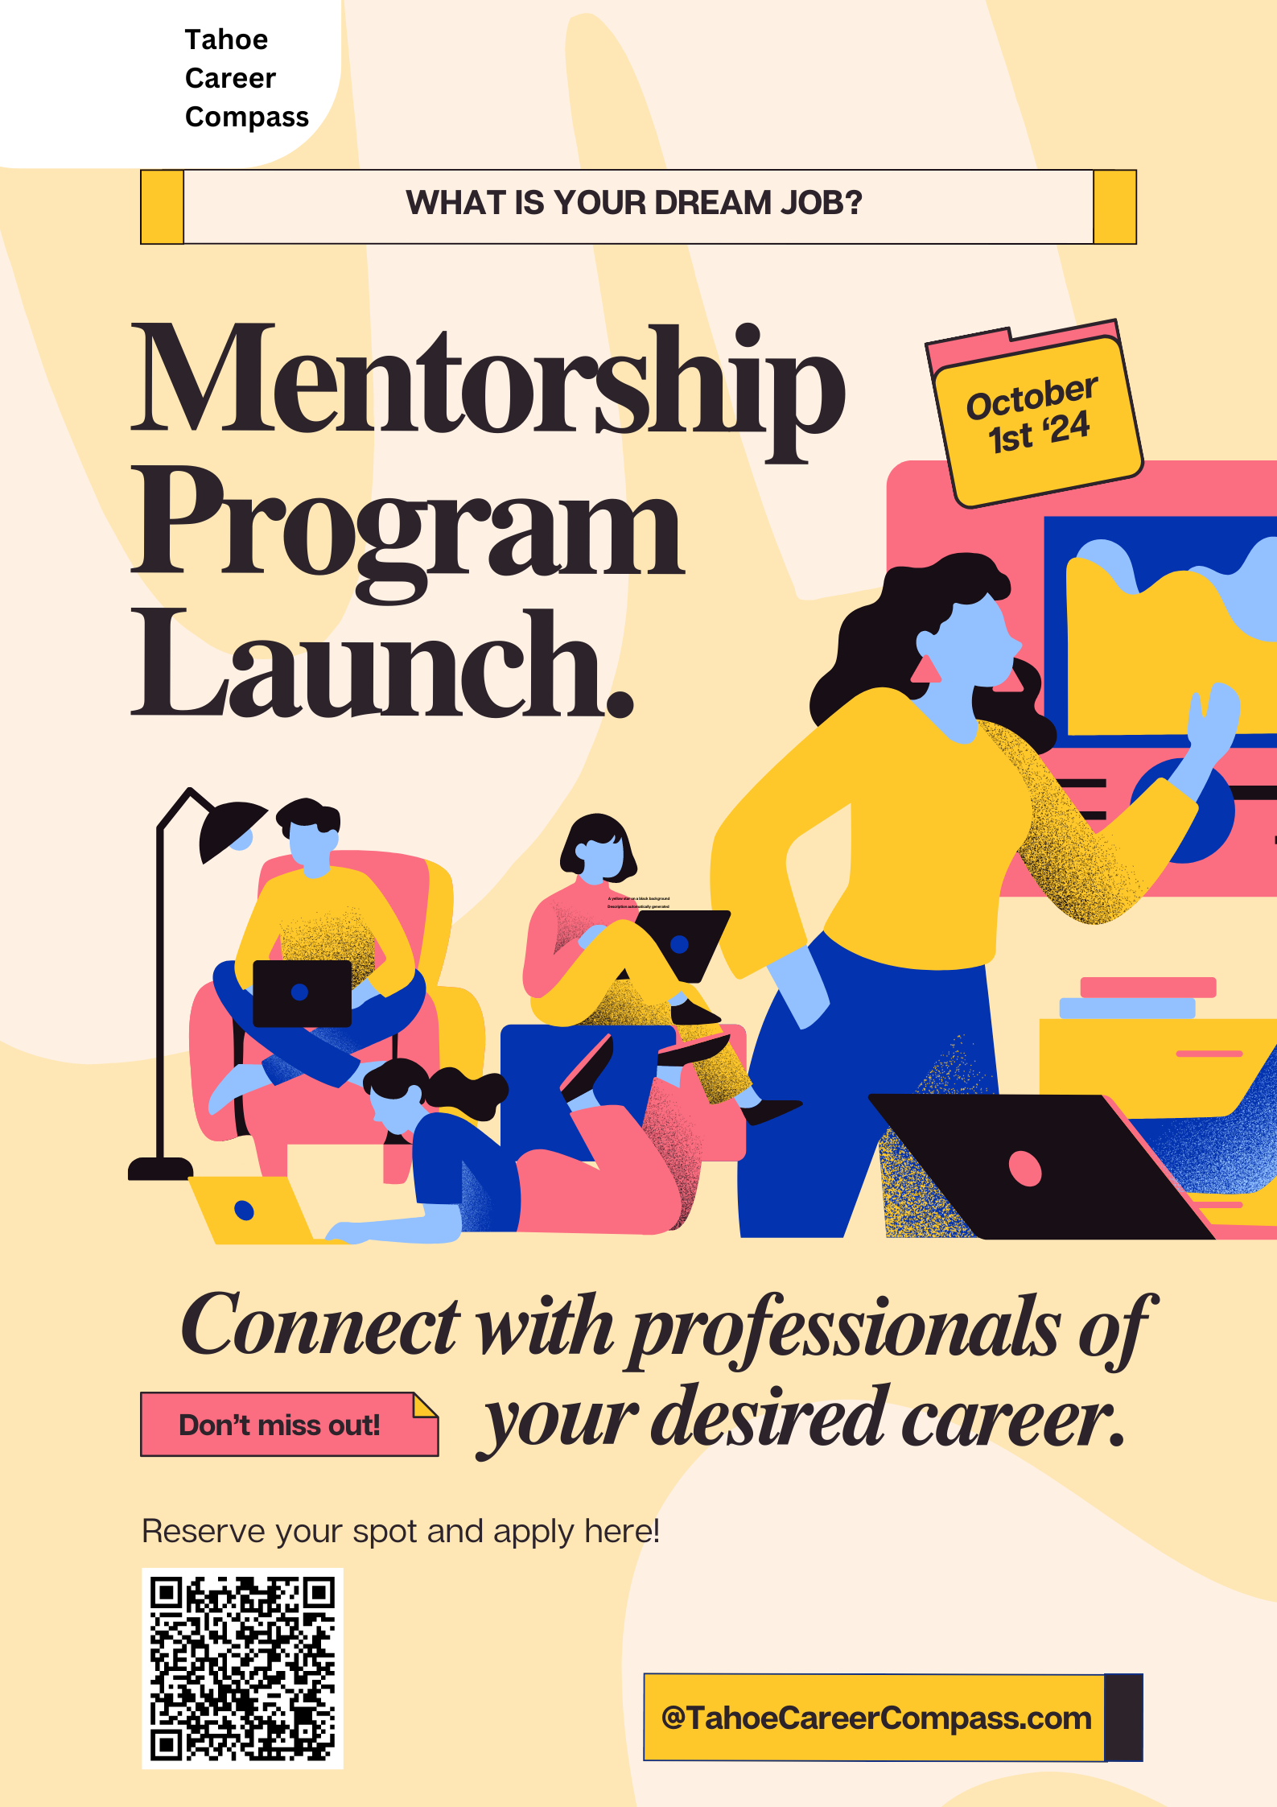
Notes:
Heiko
For High school
Add logo and Tahoe Career Compass
Replace @leadershipprogram with @tahoecareercompass

Slide 14

Brand Guidelines
Main Color Palette
Unifying Logo
Notes:
Heiko

Slide 15
Budget
Item | Amount
Website/Platform | $3,000
Website Maintenance | $2,000
Space Rental for program meetings | $2,000
Program Materials (Binders, printed handouts, etc.) | $700
Instructor | $1,000
Snacks/Refreshments | $500
Curriculum Materials | $1,000
Logistics | $1,500
Total Costs | $11,200
Notes:
Courtney
When creating our budget, we had to focus on all vital materials, resources and any work that may need compensation. This will be a working budget as more expenses will come up but we were happy that overall we came under our max budget of $15,000 to start our program so that we could have a buffer in additional expenses that we could accrue throughout the beginning process. This would be beneficial for businesses in the community as well as the youth and upcoming workforce in the Truckee-North Lake Tahoe region. We would hope to partner with interested businesses and non profits that would align with our views about benefits of the program.

Slide 16
Future initiatives
Search for opportunities for Mentors to advance their own skills
  Introduce mentor opportunities through outside avenues
Increase engagement
  Continue partnerships but increase the number of mentors and mentees
Expand into neighboring areas
  Foster collaborations with industry outside of Truckee to do externships
Notes:
Cristina

Slide 17
Thank You
Special Thank You to:
Karen Willcuts
Shannon Beets
Jaime Olson
Tahoe Truckee Unified School District Staff
Tahoe Truckee Sierra College Campus
Leadership Program Class of 2024
Truckee Sanitary District, Nevada County Public Health, Tahoe Donner Association

