Slide 1


May 19, 2022
Notes:
template with trash can in bottom right hand corner - Suzy (I’m not sure how to take it from Canva and put it here, tried the ol’ copy paste to no avail…)

Slide 2
Group Members
Julie Malkin-Manning
From Detroit, Michigan, she has lived in Incline Village since 2008 with her husband Huckleberry and dog, Fozzie.
Lori Marquette
Native Californian from Los Angeles area. Retired from Riverside County and moved to Truckee in 2014.
Terri Streetman
22-year California transplant from Florida. Has lived in Olympic Valley since March 2020.
Suzie Tarnay
Grew up in Maryland, first moved to Truckee in 94-95, has recently spammed you to attend her election fundraiser this Saturday!
Colby Wise
Longtime regional local, has been working in Tahoe City for four years.
Notes:
Suzie: I love the size and boldness of the font, but the serifs make it look “old western-y”, can we find something more modern to match with our retro 80’s vibe…
I changed the font here on half of the title, just to give an idea of what I’m talking about…
Make sure all blurbs are the same format, either phrases without punctuation, or sentences with punctuation

Slide 3
The Garbage Game
Focused on:
cleaning up garbage
exclusively along Truckee River and trails
during summer months
Rewards clean-up efforts
Encourages participants to "brag" about litter collecting while
  Rafting
  Hiking
  Biking
River and trail users will:
Be encouraged to take home their trash, and other trash along the way
Snap photos, add “Garbage Game” hashtag, post to social media
Get entered in weekly, monthly and a final prize drawing
Notes:
Duplicate slide to show short phrases that are easier to read for observers, act as notes to speaker
There is still too much text on this slide and the meat is smushed to the bottom a bit maybe?

Slide 4

Target Audience
We want EVERYONE to participate!
Locals and Visitors
Trail and River Users
Young and Old
Our goal is to change the behavior of everyone that interacts with the beautiful outdoor environment that surrounds Truckee and Tahoe.
Notes:
This one’s easy!
Not only notice the beauty around them, but to note if something is out of place—garbage—remove it!

Slide 5

Impacts
The Garbage Game Goal is simple: Encourage long-term behavior modification of litter and trash pick-up by Truckee/Tahoe area trail and river users.
Our objectives are:
Run a pilot program for the summer season with a potential final clean-up
Create a recognition and reward campaign
Establish partnerships with community stakeholders
Notes:
In other words: Our hope is that everyone will become more aware of the trash they create and the trash they encounter. Pick it up and take it home!
We discussed starting a small program to gauge the interest and willingness to participate. Ideally, the program would coincide with the summer rafting season as we’ve seen plenty of extra garbage as a result of summer recreation activities.
Our belief is that punishment campaigns seem to be ineffective. Instead, we propose creating a recognition (through social media posts) campaign along with occasional randomly drawn prizes. The season will culminate with a grand prize - something exciting like a ski pass. A side benefit of the recognition campaign would hopefully be a key part in “spreading the word.” Participants use the #GarbageGame hashtag and share it on their own pages too.
The more we work together, the more likely we are to be successful with a program like this. Think about the “keep tahoe blue” campaign that has reached so many - in a large part to community organizations and businesses willingness to help get the word out. Our final objective would be to partner with the River Raft companies, Waste Management, and the towns and counties, to help us plug the program into other organization’s websites, blogs, posts, and events.

Slide 6

Survey Implementation
JotForm - digital
Distribution
  Chambers
  Social Media
  Leadership Alum
127 participants
Approx 3 weeks

Slide 7

Survey Takeaways
60% would likely or definitely participate
Over half would share to social media
78% pick up trash often or always
  Vast majority (82%) wants more trash cans
Respondents - nature of email lists
  81% 31 to 60 years
  85% full time residents
  77% reside in 96161
Section Most In Need? - technical issue…
  43% just Tahoe City to River Ranch
  52% included All of the Above
Notes:
There is possibly way too much text here too, do you think we should just cut some?

Slide 8
Estimated Program Budget
Event Liability Insurance (TBD) | $1,000
Event Management/Gamification Software | $ 500
Promo Swag/Communication Materials | $1,500
Raffle prizes | $3,000
Graphic design/Communications | $1,000
Advertisement and social media | $3,000
Project Management Stipend (April – August) | $3,000
Reusable trash bags for rafts (50) | $1,000
Contingency fund | $1,000
TOTAL | $15,000
Notes:
Budget
Social media driven
Biggest budget item
Communication &
Marketing
Software
Raffle prizes
needed weekly

Slide 9

The Case for Funding Garbage Game: A Case for Funding
The need for graphic design and communication materials
Advertisement and social media
Hiring program manager to assist with the Gamification rules, how to reward via social media.
Potential Funding Partners/Sources
Local business sponsorships/sanitation departments
Non-profit partners and environmental groups
River rafting companies
Resort communities (Palisades, tourist organizations)

Slide 10
Notes:
Logo is retro and fun; meant to reflect gamification
Use of stickers, clings, and social media in advance of season to create interest and drive traffic to website

Slide 11
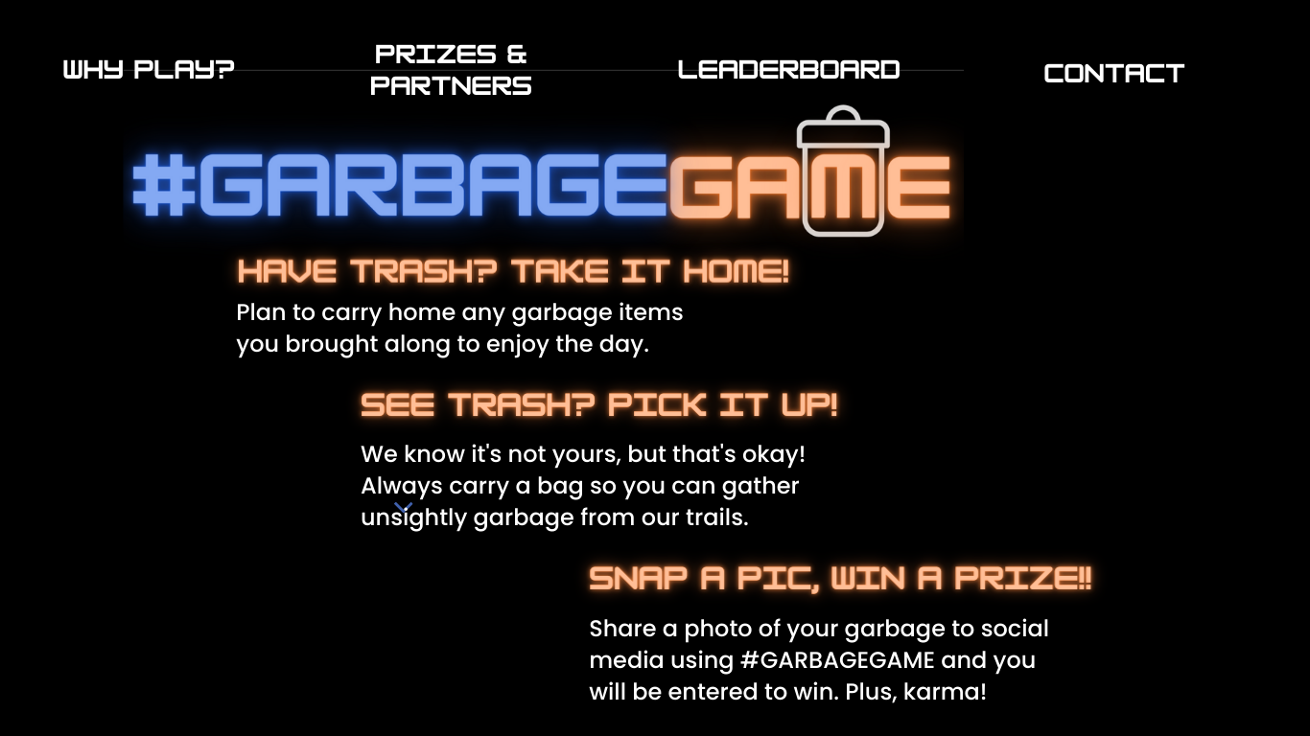
Notes:
Clean clear call to action and how to on our website

Slide 12
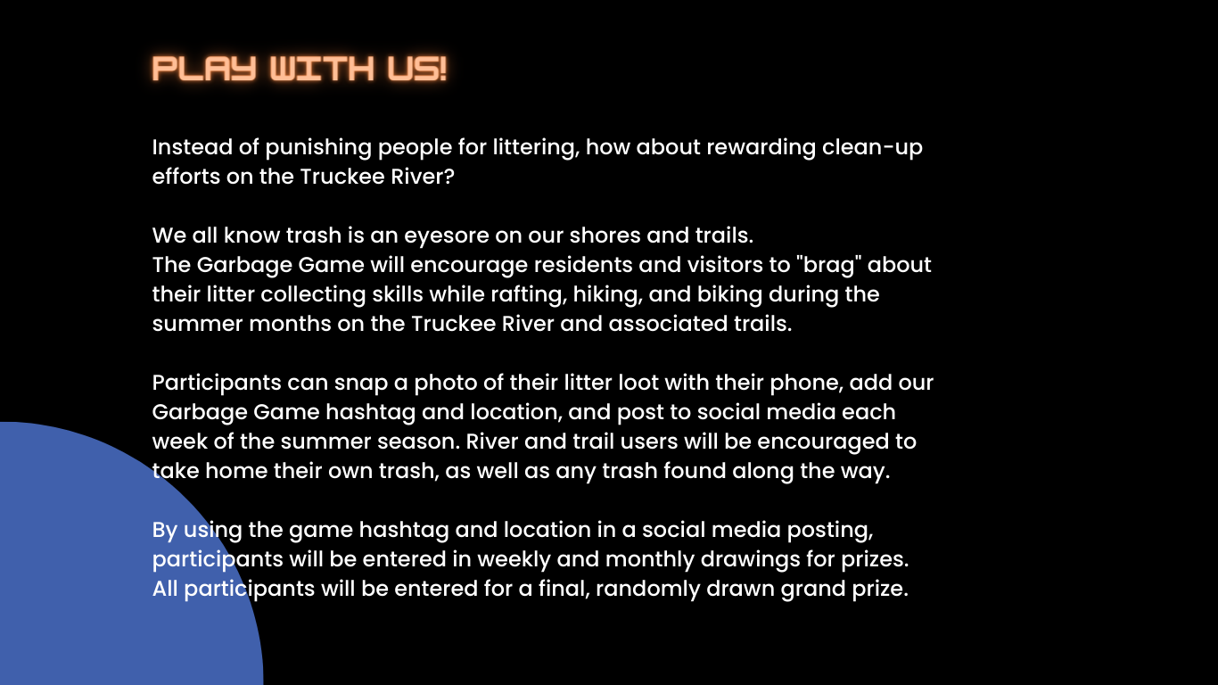
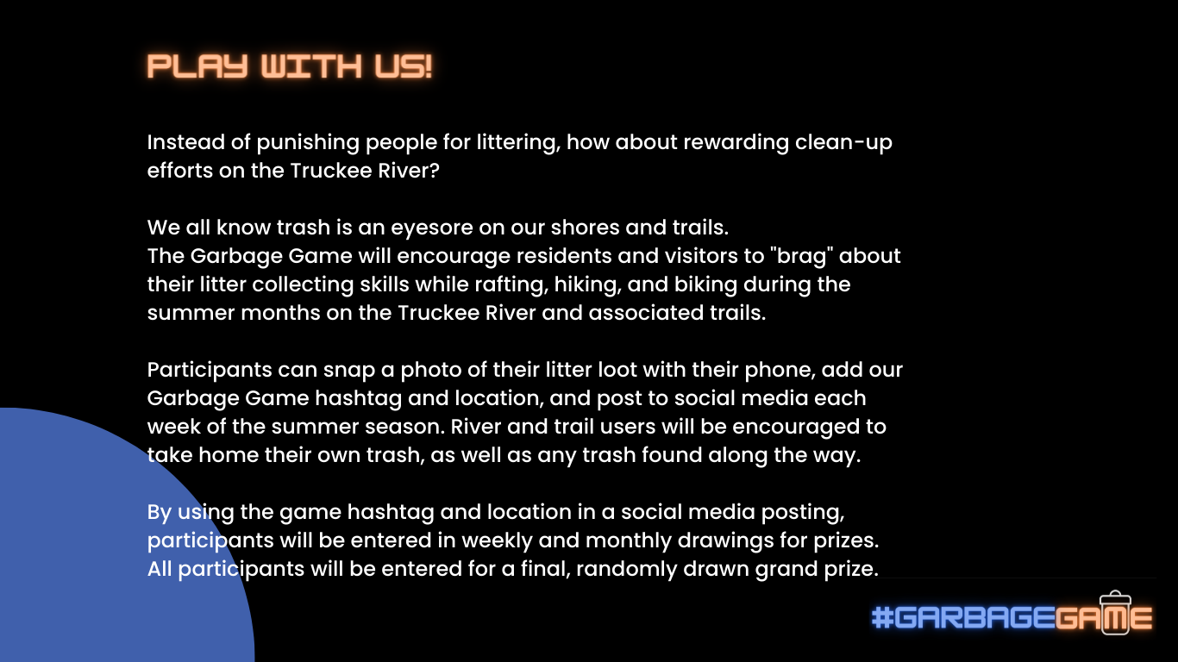
Notes:
The Why!

Slide 13

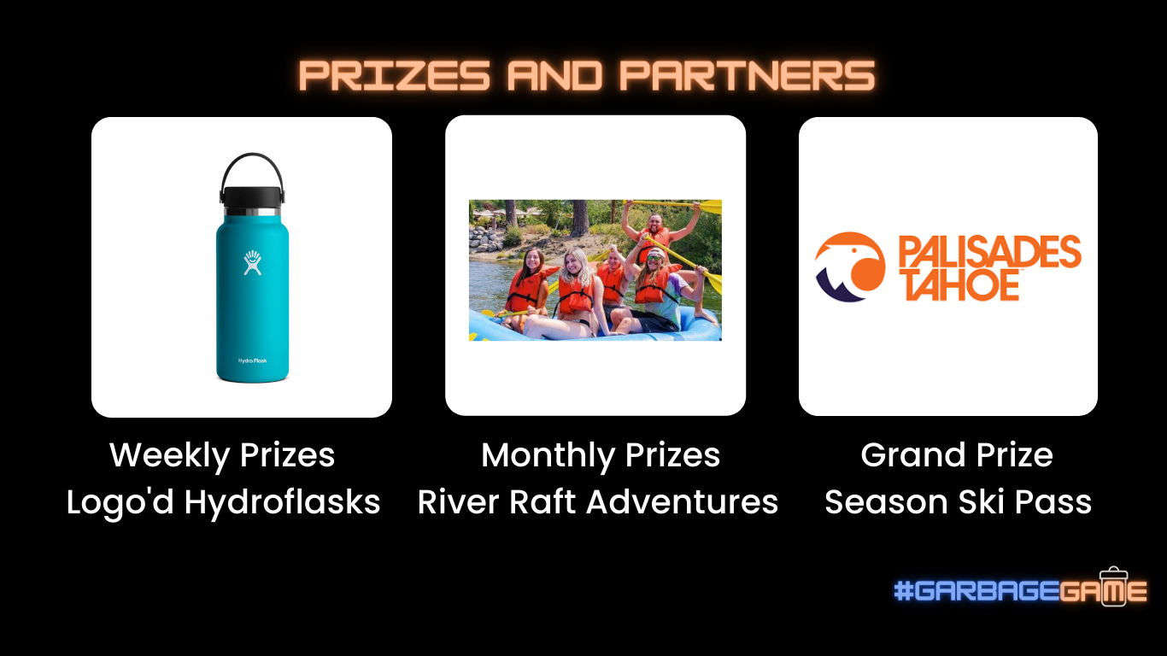
Notes:
We will feature our prizes and partners; carrying through the gamification of the campaign

Slide 14
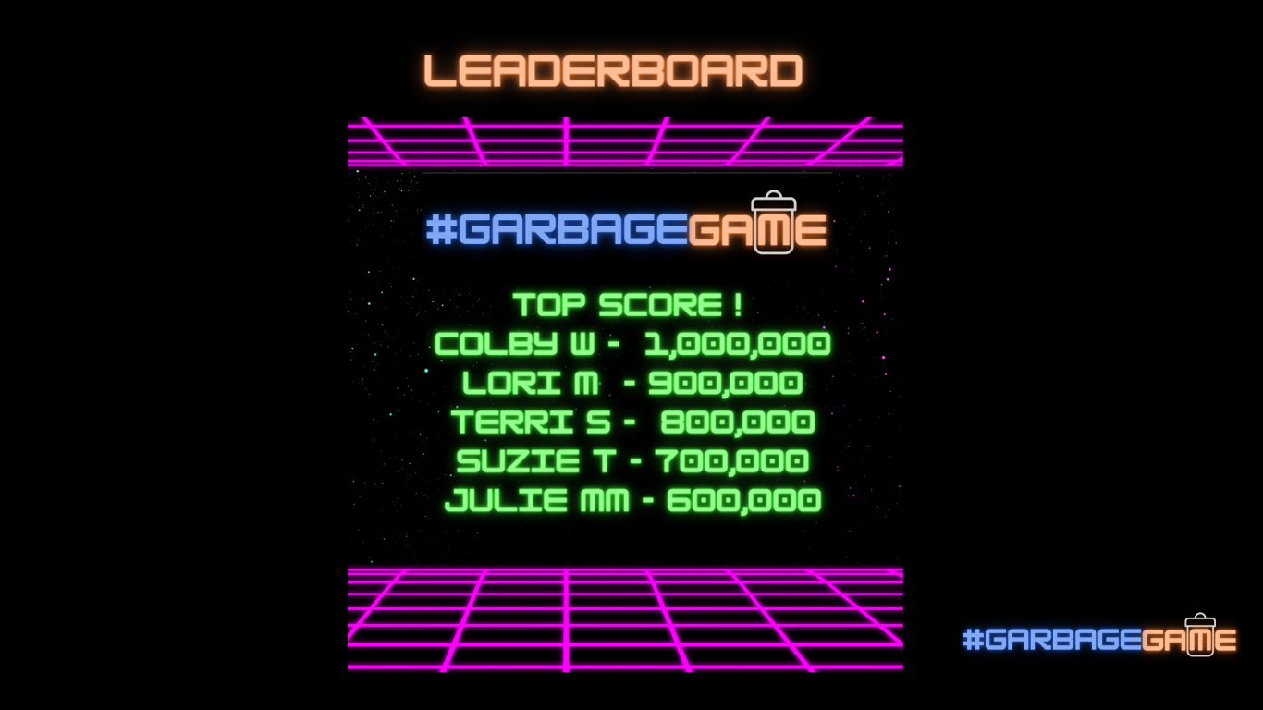
Notes:
Everybody wants to beat the top score!

Slide 15
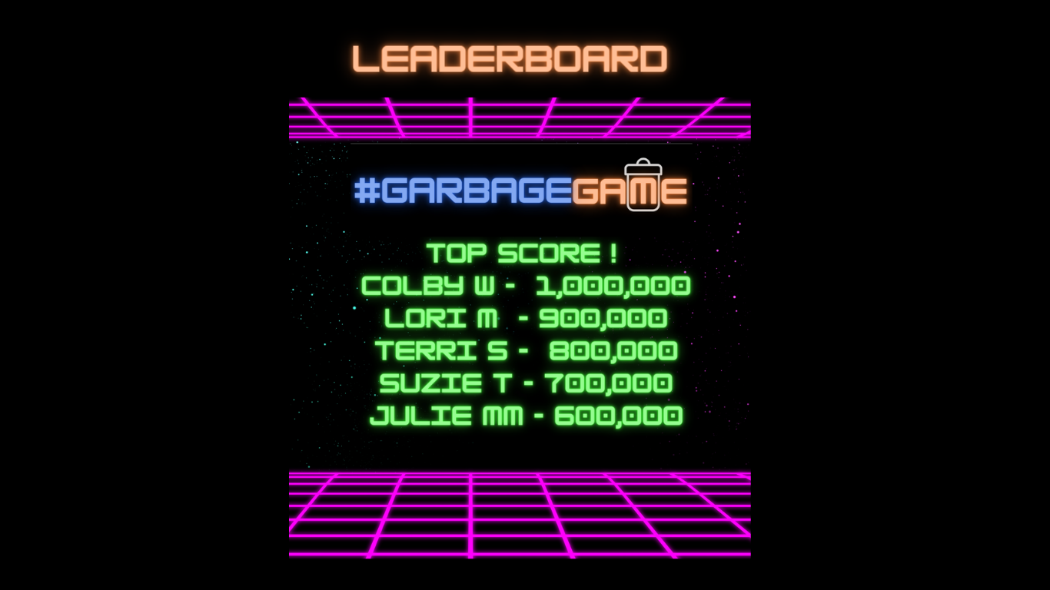

Notes:
Never leave ‘em without a way to stay connected!

Slide 16
Next Steps
Each of us is looking forward to increasing our impact in Tahoe-Truckee in various ways because of our Leadership Experience
We appreciated this opportunity to take an idea to “reality,” and learn about ourselves as individuals and group members.
Cheers Leadership Class of 2022 - we’re friends for life!
REMEMBER—there are NO LOSERS in the garbage game.
Notes:
we will create a fun environment where more trash is picked up - add pic of truckee river-

Slide 17

THANK YOU!

