Slide 1
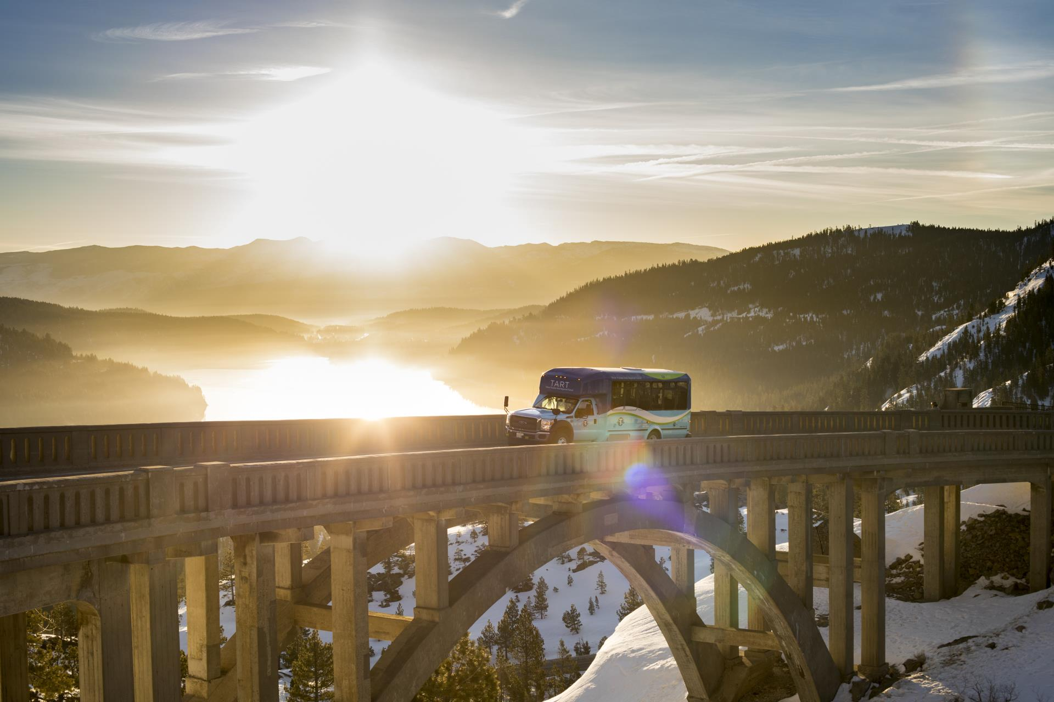
CAMPAIGN
TRANSIT INCENTIVE
LEADERSHIP
NORTH LAKE TAHOE-TRUCKEE

Slide 2
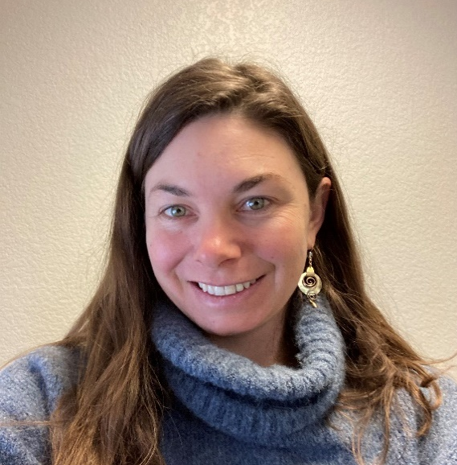
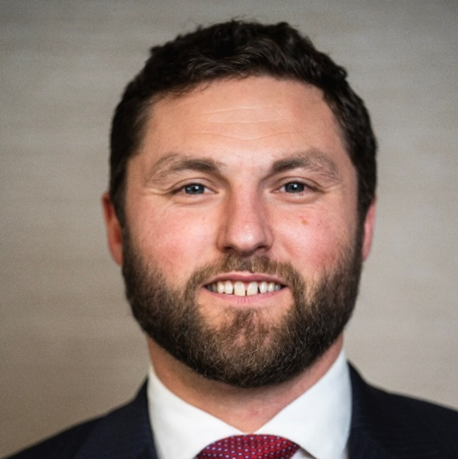
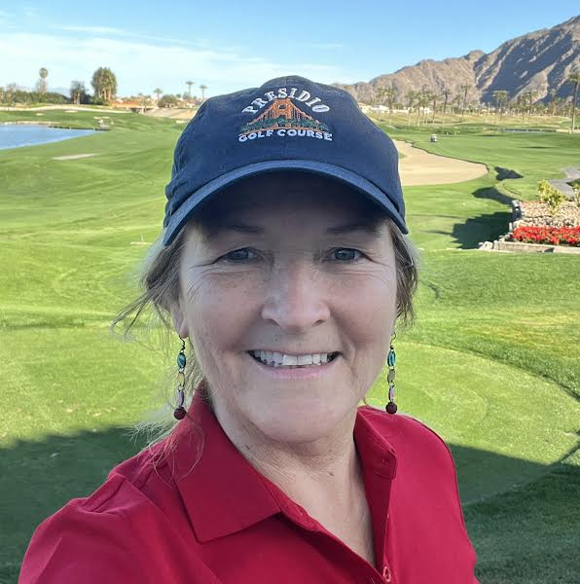
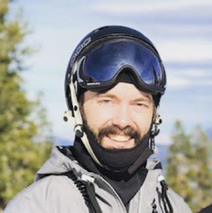
Our Team
Project
Members
Sara Van Siclen
Keenan Hawkins
Julie Petersen
Howard Hershey
Truckee North Tahoe TMA
High West Law, PC
Elements Mountain Co.
Northstar California
sara@tnttma.com
khawkins@highwestlaw.com
juliep@elementsmtn.com
hghershey@vailresorts.com

Slide 3
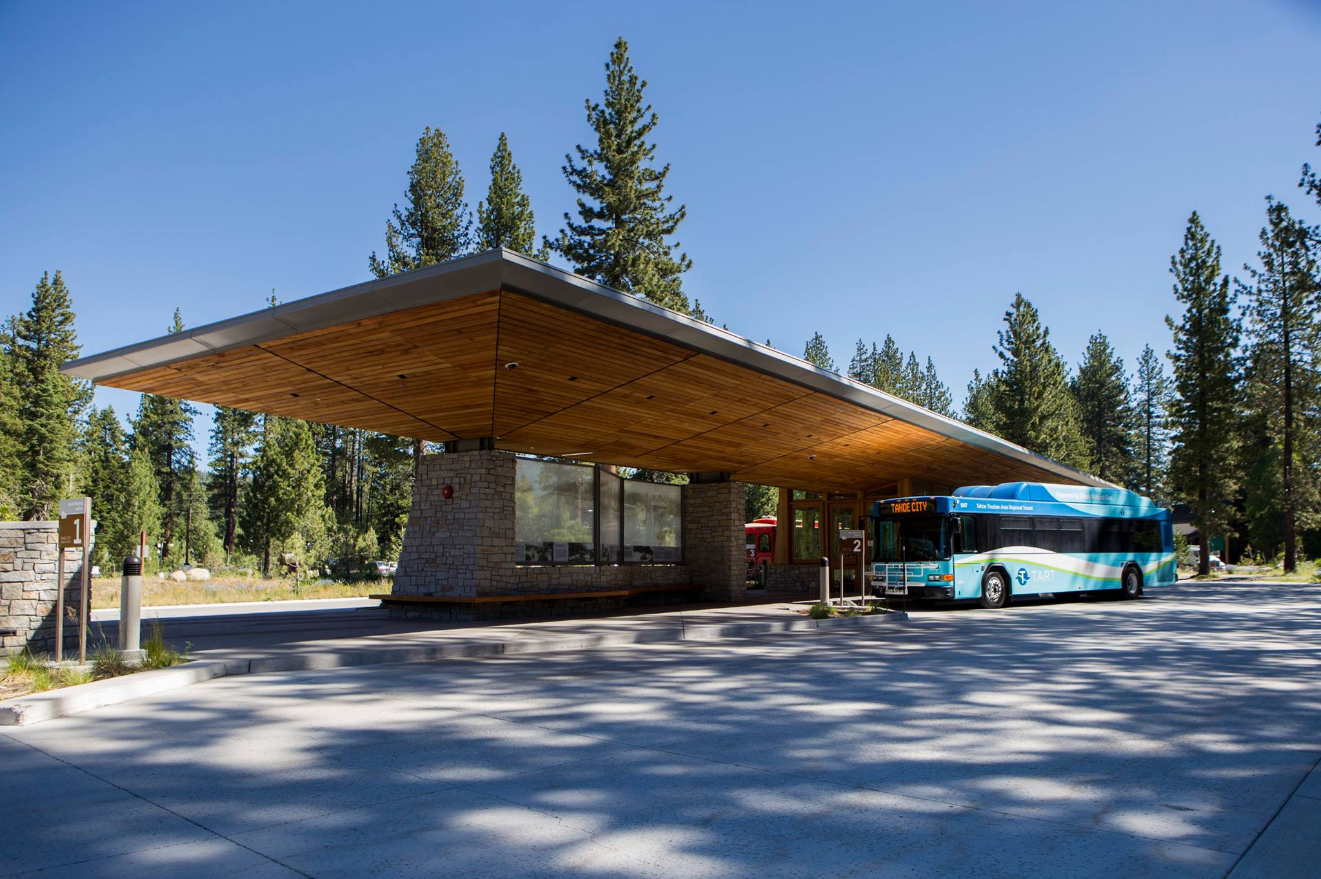

Introduction
PROJECT OVERVIEW
The Transit Incentive Campaign strives to increase Tahoe Area Regional Transit (TART) ridership by encouraging visitors and locals to use transit, and educating them on approach.
The campaign leverages multiple media platforms, and the combined draw of our region’s most popular summer events: converting infrequent riders, and adding value for regulars.
Transit incentives and parallel outreach reduce real or perceived barriers to increased ridership—remove private vehicles from our roadways, and improve regional resilience.

Slide 4



NET LOSSES
Impact
Traffic: Lost time and revenue
Environment: Reduced air and water quality
Safety: Increase in driving under the influence
Problem
INDIVIDUAL, COMMUNITY, & SOCIETY GAINS
Streamline exposure to new experiences and rewards via TART
Reinforce civic behavior with local business partnerships
Preserve scarce resources: Clear roads, water, skies

Slide 5
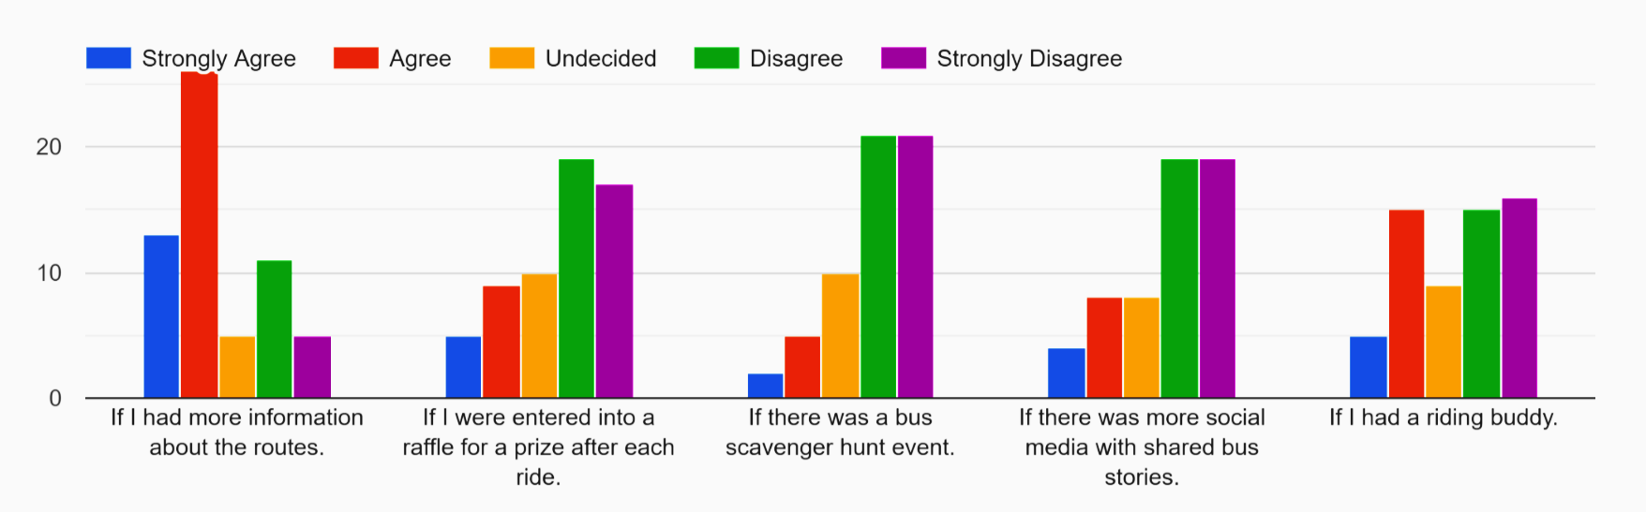
Survey
TART UTILIZATION / EVENT
FINDINGS
63 total respondents
Questions focused on transit use, incentives, and barriers
Responses indicated that the main barrier to transit use was lack of understanding how to use the service
BEHAVIOR CHANGE / INCENTIVE
I would ride the bus…
“I don’t know where to get reliable/ compete information about how, when, and where to take tart. “

Slide 6
Target Group
How often do you Ride?
90%
< 4x per year
FIRST TIME & INFREQUENT RIDERS | Experience Driven Service
.
“I didn't know TART serviced these events. Now that I know, I will utilize much more.”
75%
Demand for service logistics to summer events
Truckee Thursdays & Music on the Beach see high relative engagement*
≤ 1x per year
Responsive to local-business vs. primary incentivizes
Aligns with project effectiveness and sustainability
Demand social ‘connection’ tethered to transit use
Marketing strategy to advance diversity, inclusivity
50%
Never

Slide 7


Marketing
FIRST RIDE | Ease & Incentive
Targeted educational content and small business incentives for TART use provide a ‘foot in the door” to regular ridership
Flyer (right) and social media drive traffic to TART Taskforce website, and ‘pop-up’ event activations
Educational website minimizes research/ planning burden for new users, rectifying stigmatized aspects of public transit
Direct outreach: Co-branding with TART and local business partners for incentive fulfillment, connection, learning
Note: Physical, digital media verbiage available in English and Spanish

Slide 8
Project Budget
ITEMIZED
Event Setup
Branded ‘Pop-up’ Shelter | 2 | $700
Folding Chairs | 8 | $200
Folding Tables | 2 | $125
Branded Tablecloth | 2 | $100
Subtotal |  | $1350
Marketing
Printing | 1x | $2500
Web Design, Hosting | 1x, Monthly | $500
Creative Consult | 1x | $1250
Translation | 1x | $350
Subtotal |  | $4600
Incentive Collateral
Soft Goods | $10/ Unit | $3250
Food & Beverage | $5/ Unit | $5000
Branded Tickets (Redeemable) | 1x | $300
Subtotal |  | $8550
Miscellaneous
Legal Fees | 1x | $500
Subtotal |  | $500
Total |  | $15000
FOCUS AREAS
Event activation and animation (hard goods)
Media development services and collateral
Participant incentive collateral
Risk management services

Slide 9
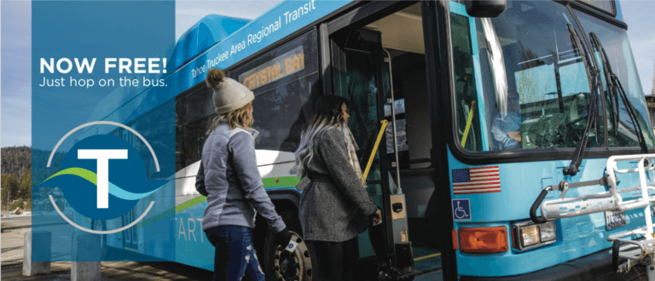
Conclusion
GO Lightly!
Increasing TART ridership is an essential component of any plan to limit regional congestion and vehicle pollution—issues presenting substantial/ growing risk to our local culture, environment, and economy.
Our project research indicates that TART ridership will increase by approximately 5% with the provision of services below:
    Narrowly-tailored messaging about how to ride TART to reach specific events
Local-business backed incentive program to drive additional engagement
Activations connecting users to services and eachother
See you
out there!

