Slide 1


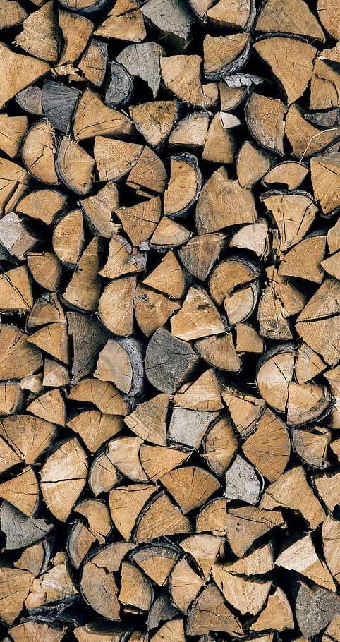
Developed By:
Riley Powers
Slater Stewart
Cory Allison
Jon Slaughter

Slide 2

Why are we here today?
“Because winters are cold and seniors are old… we are tapping into the community to provide split firewood for seniors in the Truckee-Tahoe area so they can keep warm.”
The Splitting for Seniors Program is aimed at serving our low income seniors in the area who have trouble or are unable to procure, stack, and maintain a wood supply for their primary or secondary heating source.
Notes:
Owner: Riley

Slide 3
What is the Splitting for Seniors Program?
The Wood Splitting for Seniors Program plans to provide free wood splitting, delivery, and stacking for low-income elderly members of the North Tahoe/ Truckee region.
The program will coordinate volunteers and provided a location and tools to split firewood for these seniors citizens in need.
Why is this important?
Firewood is an essential resource for living in the mountains, but procuring it can be physically arduous.
Senior citizens may have issues with mobility and strength or may be unable to split and stack their own wood.
We hope our program will give seniors easy access to the resources needed to heat their homes in the winter.
Notes:
Owner Riley

Slide 4
Target Groups
Initial surveys and marketing targeted to potential volunteers
  Want to build a base of support for the program before enrolling seniors
  Ideal volunteers should be able to:
    Carry heavy loads
    Safely operate wood splitting equipment
    Spend an entire day splitting wood, or
    Deliver and stack firewood using their own truck, or
    Shovel snow
After gathering a volunteer base, our efforts will shift to enrolling seniors
  Mobility issues
  Low income
Notes:
Owner: Slater

Slide 5
Goal
Obtain, split, deliver, stack, and maintain firewood for seniors in the Truckee-North Tahoe region.
Impact: Enrolled seniors will not have to worry about staying warm during the winter.
Objectives
Establish volunteer base
Enroll seniors
Establish 3 or more community work weekends to split, deliver, and stack
Develop partnerships with Keep Truckee Green, Tahoe Truckee Sierra Disposal, and local defensible space contractors or arborists
Develop partnerships with Sierra Community House and Sierra Senior Services
Reduction of Sheriff, Fire Department, Paramedic calls related to lack of heat in senior homes
Maintain firewood access for all enrolled seniors by shoveling within 48 hours of any 6” plus snowfall
Notes:
Owner: Slater

Slide 6
Action Plan Survey
We surveyed Truckee-Tahoe community members to see if they would consider volunteering their time to Split, Deliver, Stack and Maintain firewood for seniors in the area.
We utilized Survey Monkey to distribute the survey and collect results.
Our goal for the outcome of the survey is to gauge community interest in the program to determine if we have a viable volunteer base.
Notes:
Owner: Cory
How was survey implemented. What was learned?

Slide 7
Action Plan Survey - Results
Survey received 85 Responses
Found there would be interest in volunteering
  Willing to volunteer 1-2 hours a season for the program:
    Splitting Wood: 21%
    Delivering Wood 25%
    Stacking Wood 40%
    Clearing Snow/Woodpile Maintenance 30%
  Willing to volunteer 3-4 hours a season for the program:
    Splitting Wood: 8%
    Delivering Wood 11%
    Stacking Wood 10%
    Clearing Snow/Woodpile Maintenance 5%
Notes:
Owner: Cory
How was survey implemented. What was learned?

Slide 8
Action Plan Survey - Results
Received multiple comments that they did not have a truck or own the tools needed and believed it was a barrier.
  Clarified our action plan that tools would be included.
Even though about half of survey respondents said that they would not be interested in volunteering, the amount that did have interest gave us confidence that this could be a viable program.
Notes:
Owner: Cory
How was survey implemented. What was learned?

Slide 9
Action Plan Budget
Item Amount
2 hydraulic wood splitters $800
10 mauls $400
10 hatchets $300
6 wheelbarrows $360
50 sets of work gloves $100
50 sets of safety glasses $100
First aid equipment $100
Social media ads $1,000
Radio ads $500
Flyers $100
Fuel $2,500
Administration $8,740
TOTAL: $15,000
Notes:
Owner Cory - The project was given a $15,000 budget and this is how we allocated the money, splitting between tools and administration. In reality we believe this could be done with less money, relating on a volunteer base. This budget is still relying on the wood and a space being donated.

Slide 10

Marketing
The focus of marketing efforts will be put into recruiting volunteers for the program. While we will also need to find interested parties willing to accept the wood, we feel the demand is high and if we provide the service a viable market will be easy to tap.
Volunteer Recruiting Plan:
  Local flyer distribution
  Social media content strategy leveraging influential community leaders, athletes and personalities
  Local Truckee-Tahoe Radio campaign including Community Calendar listings and staff interviews
  Digital ad campaign using Google, Meta & programmatic ad networks.
  Outreach at community events (i.e. Truckee Thursdays, Music at Commons Beach)
  Targeted outreach to local high schools for volunteer commitments
  Partner with local business and organizations which have affiliations with target segments (i.e. Sierra Community House, Truckee Rents, Keep Truckee Green, Tahoe-Truckee Sierra Disposal, Elements)
Notes:
Owner: Jon

Slide 11
Conclusion & Next Steps
The Splitting for Seniors team is excited to kick-off the program this summer. We plan to immediately begin volunteer recruitment. Meanwhile, on a parallel path program managers will start finding resources, developing partnerships and begin outreach to local seniors in need of our services. A product extension to other locals in need if the market segment of seniors is not large enough based on the volunteer base and resources available.
Next Steps:
  June 2023, Begin recruitment of volunteers
  July 2023, Source equipment, local partners and wood resources
  August 2023, Begin outreach to find seniors in need.
  September 2023, Plan and promote community work days
  October 2023, Begin wood deliveries to enrolled seniors
  Start recruitment and parallel path to begin finding resources, non-profit partners and finding seniors in need.
  Winter 2023-2024, Help Others Enjoy a Warm Fire
Notes:
Owner: Jon. Sept 16th first community wood splitting day.

Slide 12
Thank You
Thank you for joining us today. We would love to have you join us as a volunteer or welcome your support to help bring this program to life.
Key Dates:
Volunteer Recruitment: June 2023
Senior Recruitment: August 2023
Community Wood Splitting Dates: September 16, September 24 & October 14
Questions?

