Slide 1
Welcome to the Mountains
Be a Good Tahoe-Truckee Neighbor

Slide 2
Good Neighbor tAHOE tRUCKEE
Welcome to Mountain Living! In an effort to highlight our regional ways of living to protect our fragile environment, secure our limited resources and foster our communal spirit, we have put together some tips on ways that you can be a good neighbor.
Current good neighbor policies are directed at Short-Term rentals; our intent is to educate all Tahoe-Truckee residents on how to be good neighbors in our shared mountain community.

Slide 3
WHOA!
What’s going
on here?

Slide 4
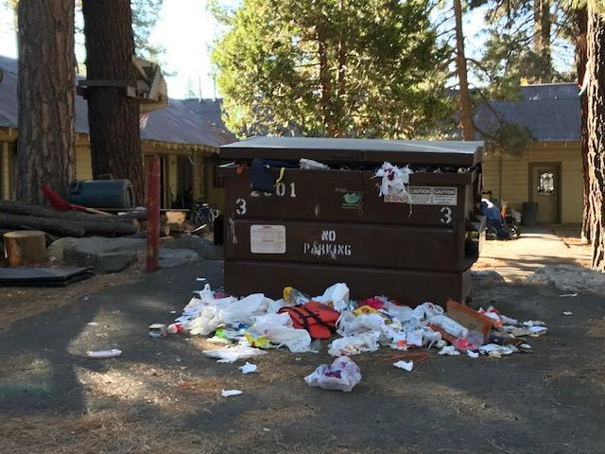

Slide 5
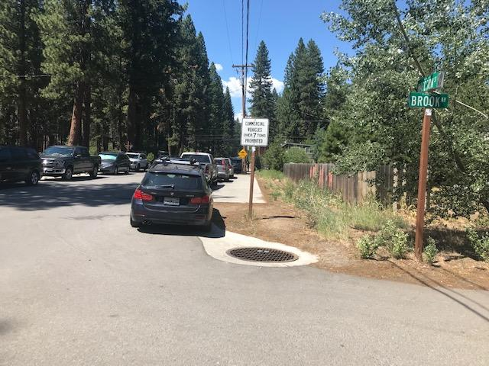

Slide 6
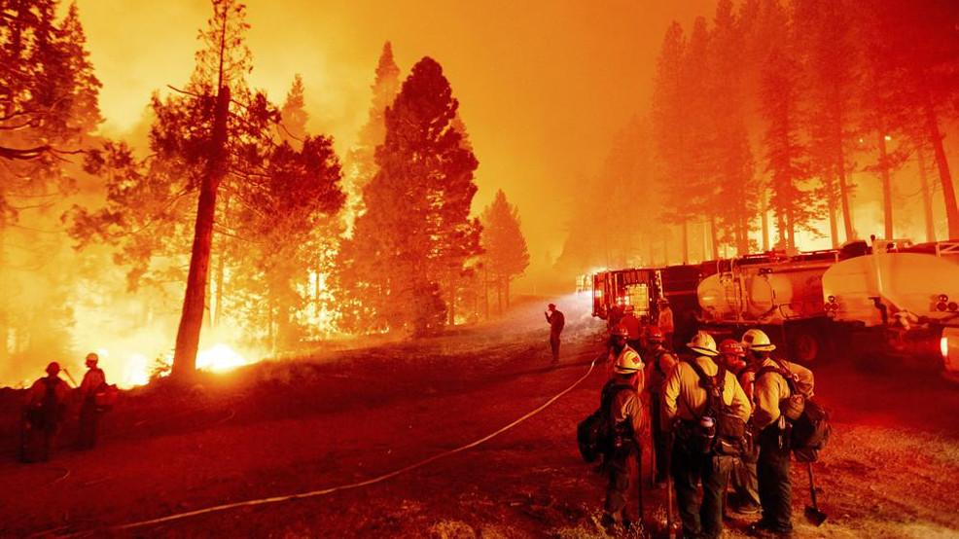

Slide 7
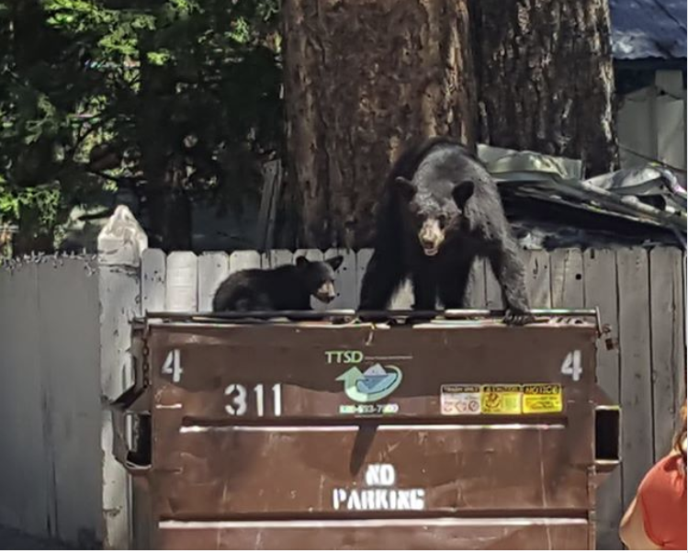

Slide 8



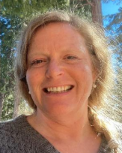
OUR TEAM
Cirra mason
Brian peart
Alyssa reilly
Viktoria rollston

Slide 9
Survey Results
72 Total Responses
Location results:
50% Truckee
17% West Shore
15% Kings Beach/Tahoe Vista
8% Tahoe City
Type of “Neighbor”:
95% Full-Time Residents

Slide 10
What’s your definition of a “Good Neighbor”?
“Looking out for on another - lending a hand when you can”
“Friendly and polite - following the rules and tips for living in Lake Tahoe”
“Someone who respects the people, property and environment around them”
“One who respects their human and animal neighbors”
“Respectful to others when it comes to noise, light and trash”
“Friendly, aware, respectful, kind and considerate”
50%+ of responses said respect/respectful

Slide 11
Survey Results
Were you previously Aware of the current Good Neighbor POlicies?
77% Answered NO
Current Good Neighbor policies - Placer County went into effect 3/11/2022
Town of Truckee June 2021
The current policies are directed at Short-Term Rentals and rental owners/ property managers. Our survey helped to shift our overall action plan direction

Slide 12
Survey Results
Have you experienced a situation where someone hasn’t acted as a good neighbor?
80% Said YES
If yes, what was the issue and how was it resolved?
60% went unresolved
Issues Included:
Trash, noise, lights, pets, use of outdoor fire during red flag, Short-term rental issues
Those that did resolve:
Through code enforcement, courts, talking with owners/neighbors, law enforcement

Slide 13
Which current Policy guidelines do you feel are most important to being a good neighbor
Trash - 74%
Noise - 76%
Fire Restrictions- 41%
Parking - 37%
Wildlife/Bears - 27%
**Percentages based on top 3 choices selected out of 10 total options**

Slide 14
Which current Policy guidelines do you feel are missing
Light pollution
Enforcement of current codes within Placer County and Town of Truckee
Education on current policies

Slide 15
Survey Summary
What we learned:
We learned that current policies have short term rentals and visitors covered
There is a gap in education for our full-time, part-time and new local residents
There is a lack of knowledge of the current policies and enforcement that is in place around trash, fire restrictions, noise, etc.
Helped to drive our current marketing materials and plan
Helped in our overall action plan shift:
  Focusing on the full-time, part-time, second home-owner and new residents

Slide 16
Our Goal: To create a positive, Respectful connection between Locals, new residents and second homeowners by educating them on our regional ways of living and the importance of being a good neighbor in our
lake Tahoe - Truckee community.

Slide 17
Good neighbor objectives
1
2
3
4
Educate all Lake Tahoe-Truckee residents on regional ways of living
Create cohesive community Good Neighbor guidelines
Ensure future stability of our fragile environment and limited resources
Create a positive respectful connection between locals, new residents and second homeowners

Slide 18
focal points of Good neighbor Flier
Noise
Trash
wildfire
Parking
Bears/wildlife
Outdoor lighting
Snow removal
Emergency alerts

Slide 19
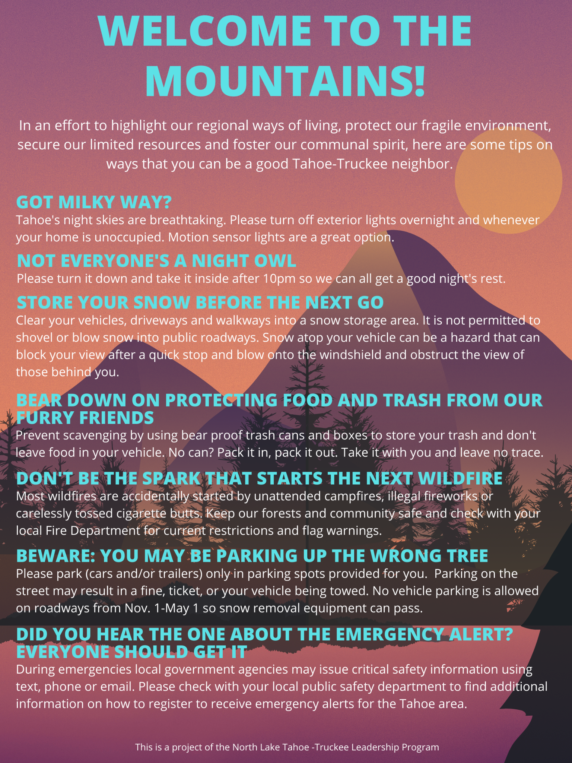

Slide 20
Positive impacts of Good Neighbor flier
Respect
cohesion
humor
inclusion
Community
Educate
Learning about our regional ways of living will help everyone to be more respectful of one another.
If we all embrace our regional ways of living it help us all be unified in our behaviors.
By educating all residents in our regional ways of living using humor it is less confrontational and more unifying.
Sometimes we forget that not everyone is familiar with our regional ways of living. We want to distribute some tips on mountain living to all Tahoe-Truckee residents.
We wish for all Tahoe-Truckee residents to be active partners in our community and hope our good neighbor tips will help us live together in greater harmony.
Our tips may help to ease tensions as we do have regional ways of living and hope we can all learn to adopt them.

Slide 21
implementation
Work with utility district partners to implement initial mailing to all accounts and ongoing mailing to all new owners and accounts
Promote via social media, chamber and community newsletters
Create content for radio promotion via KTKE and KRLT

Slide 22
Target Market
All homeowners and renters serviced by our partner utility districts
North Tahoe Public Utility District - NTPUD - 5,524 accounts
Squaw Valley Public Service District - SVPSD - 1,032 accounts
Tahoe City Public Utility District - TCPUD - 7,742 accounts
Alpine Springs County Water District - ACSWD - approx 500 accounts
Truckee Sanitary District - TSD - 13,400 accounts
South Tahoe Public Utility District - STPUD - 14,000 accounts
Incline Village General Improvement District - IVGID - 4,410 accounts
Approximately 46,600 accounts
Source - District websites
ACSWD - customer data not available

Slide 23
Year One Budget
Initial Printing¹ | 11,650
Annual Printing² | 1,000
Postage³ | 550
Staff Time⁴ | 1,800
Total | $ 15,000
1. Initial mailing to all NTPUD, SVPSD, TCPUD, ACSWD, TSD, STPUD and IVGID customers - approximately 46,400 at $0.25 each
2. New account/owner mailing, approximately 4,000 based on 24 month home sales data - May 1 - April 30
3. Most postage expense would be included in existing mail/email costs for customer bills - projection for overage
4. 3 hours per month to coordinate with partner utility districts, make updates and provide support

Slide 24
Potential Funding Sources
Community Donations
Local area grants from
Take Care Tahoe via Tahoe Fund
Tahoe Truckee Community Foundation
Tahoe Mountain Resort Foundation
Tahoe Prosperity Center

Slide 25
WHAT’S NEXT?
MEET WITH UTILITY DISTRICTS TO PRESENT PLAN AND CREATE PARTNERSHIPS
SECURE FUNDING VIA LOCAL GRANTS AND COMMUNITY DONATIONS
DISTRIBUTE FLIERS AND PROGRAM INFORMATION VIA SOCIAL MEDIA AND LOCAL CHAMBER NEWSLETTERS
OFFICIAL PROGRAM LAUNCH - FALL 2022

Slide 26
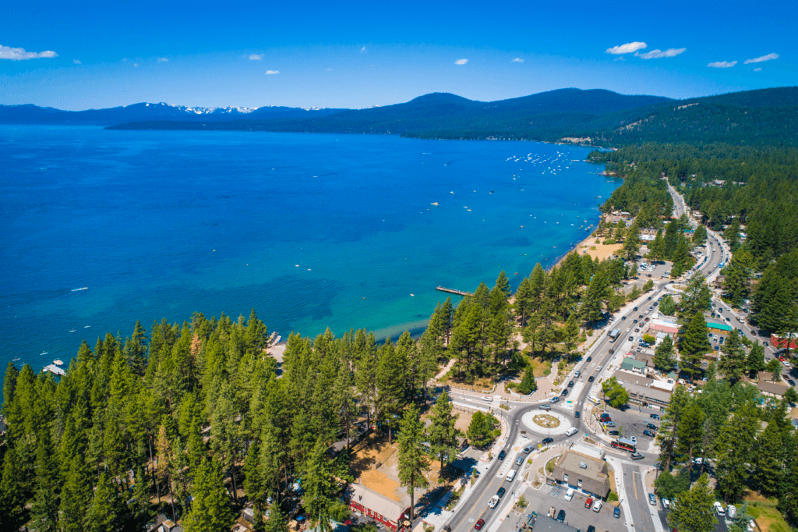
THANK You
Do you have any questions?

